Slide 1
HNC Computing - Databases
Introduction to MS – Access RDBMS

Slide 2
MS –Access DB Objects Overview
MS-Access DB makes use of 4- key objects in the database design and implementation
Tables,
Queries
Forms
Reports
Data types dictionary
Data Relationships – Primary Keys & Foreign Keys

Slide 3
MS –Access DB Objects Overview
Tables
Table is an object that is used to define and store data. When you create a new table, Access asks you to define fields which is also known as column headings
Each field must have a unique name, and data type.
Tables contain fields or columns that store different kinds of data, such as a name or an address, and records or rows that collect all the information about a particular instance of the subject, such as all the information about a customer or employee etc.
You can define a primary key, one or more fields that have a unique value for each record, and one or more indexes on each table to help retrieve your data more quickly.

Slide 4
MS –Access DB Objects Overview
Queries
An object that provides a custom view of data from one or more tables.
Queries are a way of searching for and compiling data from one or more tables. Each field must have a unique name, and data type.
Running a query is like asking a detailed question of your database.
When you build a query in Access, you are defining specific search conditions to find exactly the data you want.
You can define queries to Select, Update, Insert, or Delete data.
You can also define queries that create new tables from data in one or more existing tables.

Slide 5
MS –Access DB Objects Overview
Forms
Form is an object in a desktop database designed primarily for data input or display or for control of application execution.
You use forms to customize the presentation of data that your application extracts from queries or tables..
Forms are used for entering, modifying, and viewing records.
The reason forms are used so often is that they are an easy way to guide people toward entering data correctly.
When you enter information into a form in Access, the data goes exactly where the database designer wants it to go in one or more related tables.

Slide 6
MS –Access DB Objects Overview
Reports
Report is an object in desktop databases designed for formatting, calculating, printing, and summarizing selected data..
You use forms to customize the presentation of data that your application extracts from queries or tables..
You can view a report on your screen before you print it.
If forms are for input purposes, then reports are for output.
Anything you plan to print deserves a report, whether it is a list of names and addresses, a financial summary for a period, or a set of mailing labels.
Reports are useful because they allow you to present components of your database in an easy-to-read format.
You can even customize a report's appearance to make it visually appealing.
Access offers you the ability to create a report from any table or query.

Slide 7
MS –Access DB Objects Overview
Data types Dictionary
Data Type | Description | Size
Short Text | Text or combinations of text and numbers, including numbers that do not require calculating (e.g. phone numbers). | Up to 255 characters
Long Text | Lengthy text or combinations of text and numbers. | Up to 63, 999 characters
Number | Numeric data used in mathematical calculations. | 1, 2, 4, or 8 bytes (16 bytes if set to Replication ID).
Date/Time | Date and time values for the years 100 through 9999. | 8 bytes
Currency | Currency values and numeric data used in mathematical calculations involving data with one to four decimal places | 8 bytes
AutoNumber | A unique sequential (incremented by 1) number or random number assigned by Microsoft Access whenever a new record is added to a table. | 4 bytes (16 bytes if set to Replication ID)
Yes/No | Yes and No values and fields that contain only one of two values (Yes/No, True/False, or On/Off). | 1 bit

Slide 8
MS –Access DB Objects Overview
Data Relationship
Primary Keys:
Consists of one or more columns whose data contained within is used to uniquely identify each row in the table.
Primary keys must contain UNIQUE values, and cannot contain NULL values
A table can have only one primary key, which may consist of single or multiple fields
Foreign Keys:
Is a set of one or more columns in a table that refers to the primary key in another table
A FOREIGN KEY is a key used to link two tables together
A FOREIGN KEY in a table points to a PRIMARY KEY in another table.

Slide 9
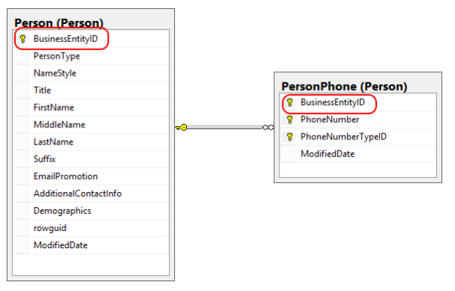
MS –Access DB Objects Overview
Data Relationship

Slide 10
MS – Access Practical Session

Slide 11
MS – Access Practical Session Outline
Week | MS –Access Lessons | Source/Link
3 | Introduction Loading MS-Access Templates Loading new MS-Access Creating Tables Adding Data to Tables Editing Tables | https://www.tutorialspoint.com/ms_access/index.htm
4 | Introduction GCF Lessons 1 – 7 All challenges should be completed and submitted | https://www.gcflearnfree.org/access2010/
5 | Working With Queries Query Data Query Criteria Action Queries Create Queries You should create MS Access queries and save file. | https://www.tutorialspoint.com/ms_access/index.htm

Slide 12
MS – Access Practical Session Outline
Week | MS –Access Lessons | Source/Link
6 | Working With Forms Create Forms Modify/Edit Forms Navigate Forms You should create MS Access form and save file. | https://www.tutorialspoint.com/ms_access/index.htm
7 | Working With Reports Create Reports Modify/Edit Reports You should create MS Access report and save file. | https://www.tutorialspoint.com/ms_access/index.htm
8 | More on Forms, Queries & Reports GCF Lessons 8 - 11 All challenges should be completed and submitted | https://www.gcflearnfree.org/access2010/

Slide 13
MS – Access Practical Session Outline
Week | MS –Access Lessons | Source/Link
9 | Class Project Assessment Prep Tutorial to be done and submitted
10 | Assessment
11 | Resit/Remediation

